Slide 1
Parent Academy Learning Session
Topic: Getting started with FRECKLE
Facilitator: Lindia Sanders, ELA Coordinator

Slide 2
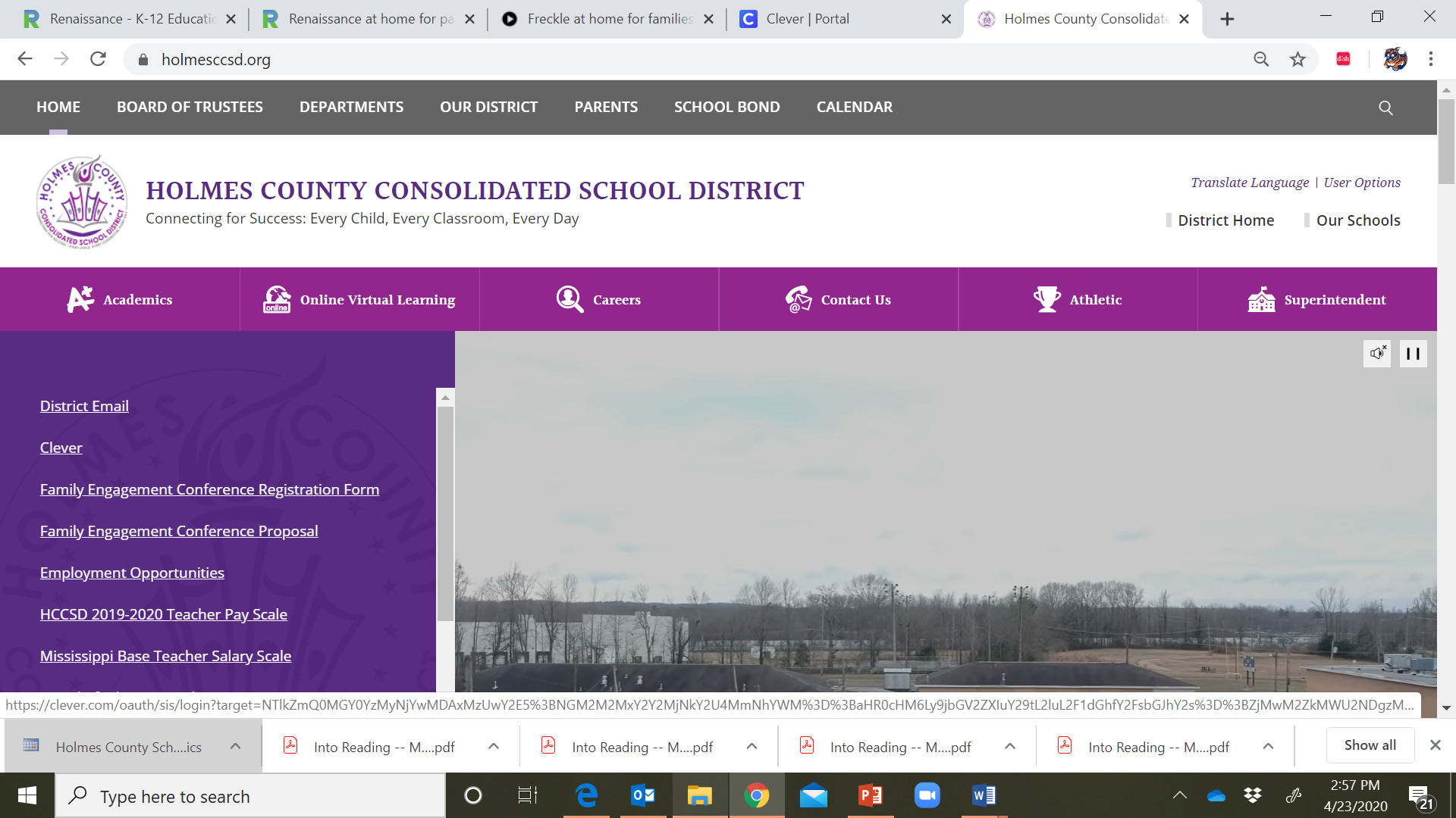
Getting started with FRECKLE
Start on the Holmes County Consolidated School District (HCCSD) website;
Go to the Online Virtual Learning (OVL) page, or
If you already have your Freckle account information you can go straight to your child’s Clever account to login.

Slide 3
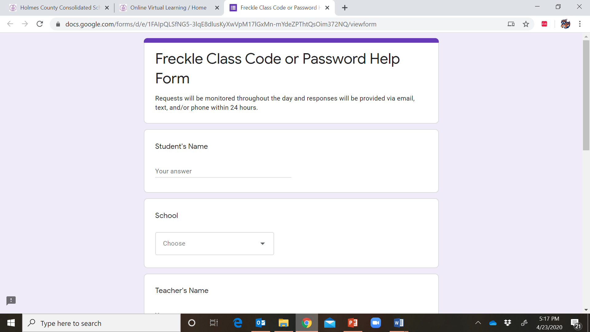
Getting started with FRECKLE
Online Virtual Learning Page
Click on the FRECKLE link to access your child’s clever account;
If you do not know your child’s Freckle Class Code or Password information, click Need Freckle Code or Password to complete a form. Someone will contact you within 24 hours.
Freckle Class Code or Password Help Form

Slide 4
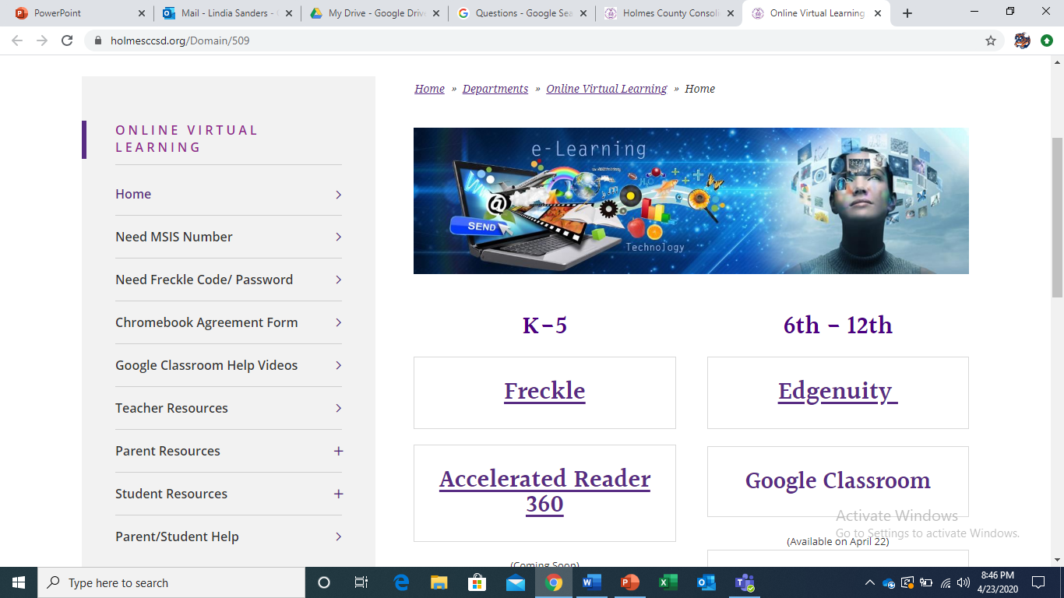
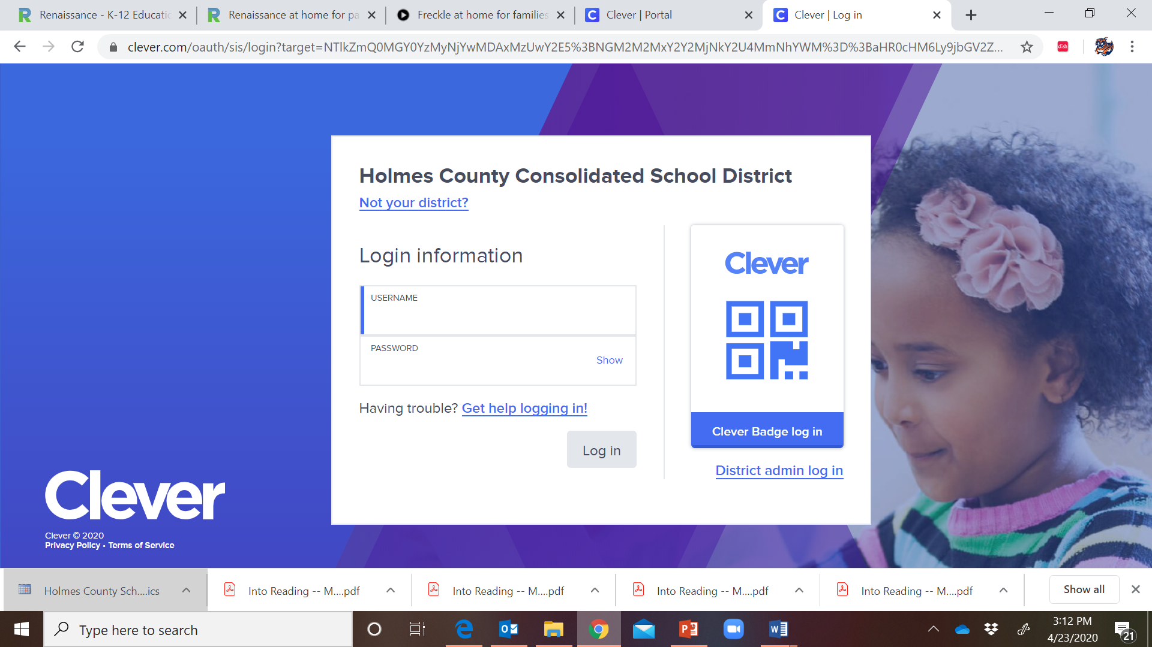
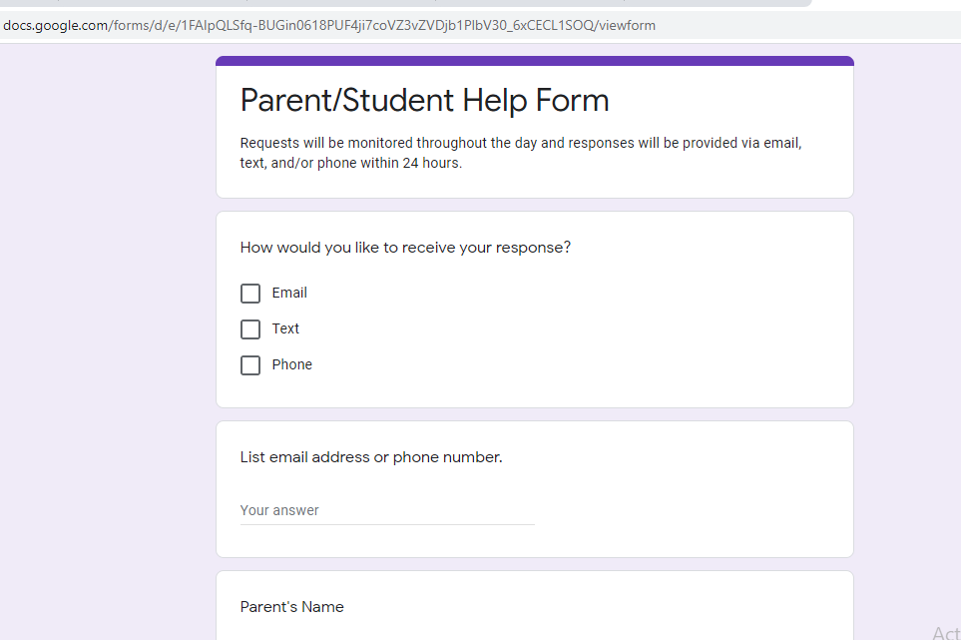
Getting started with FRECKLE
Your child’s district email and password go here
“Remember to go back to the OVL page for help if you do not have this information.”

Slide 5
Getting started with FRECKLE
Click the “Freckle by Renaissance” icon;
This will take you to the Freckle site for HCCSD students.

Slide 6
Getting started with FRECKLE
Sign In as a STUDENT with your child’s login information
Reminder:

Slide 7
Getting started with FRECKLE
Enter your child’s class code, then click the arrow to continue;
This is the unique code assigned by his/her teacher.

Slide 8
Getting started with FRECKLE
Lower Elementary
Upper Elementary/Middle School
Depending on your child’s age/grade he/she may have to select/type their name as their teachers have entered them.

Slide 9
Getting started with FRECKLE
Students will then enter their unique password;
If you do not have this information utilize the Freckle Password Help form discussed earlier.

Slide 10
Getting started with FRECKLE
Students will take a pre-assessment to get started.
This short diagnostic will help to ensure students are working at their own levels.

Slide 11
Getting started with FRECKLE
Your child’s dashboard will show what programs and assignments he/she has access to.
Teachers may assign math practice, ELA practice, social studies or science articles to students.
Students should focus on assignments from their teacher before moving on to other activities in Freckle.

Slide 12
Click the following links for additional help or information…
Using an Existing Freckle Account at Home
Freckle at Home: A Guide for Families
Freckle Support Center

Slide 13
Lindia Sanders, ELA Coordinator lsanders@holmesccsd.org

